Slide 1
Integrating Pattern- and Fact-based Fake News Detection via
Model Preference Learning
Qiang Sheng, Xueyao Zhang
Institute of Computing Technology,
Chinese Academy of Sciences
University of Chinese Academy of
Sciences
Juan Cao
Institute of Computing Technology,
Chinese Academy of Sciences
University of Chinese Academy of
Sciences
Lei Zhong
Institute of Computing Technology,
Chinese Academy of Sciences
University of Chinese Academy of
Sciences
CIKM 2021
Code: https://github.com/ICTMCG/Pref-FEND
Zhuomin Chen
2021.12.22

Slide 2
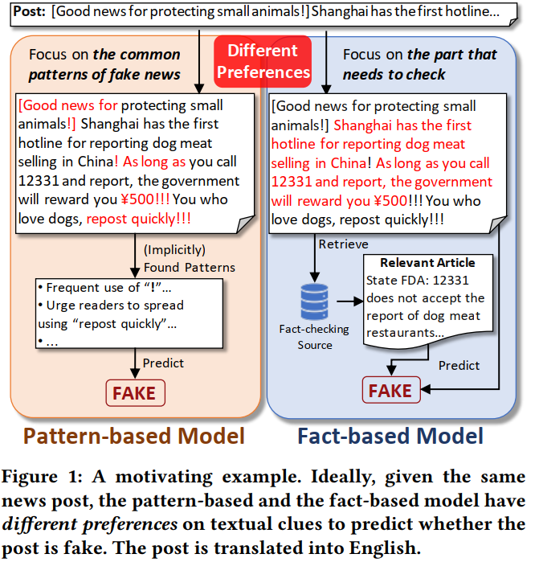
Introduction

Slide 3
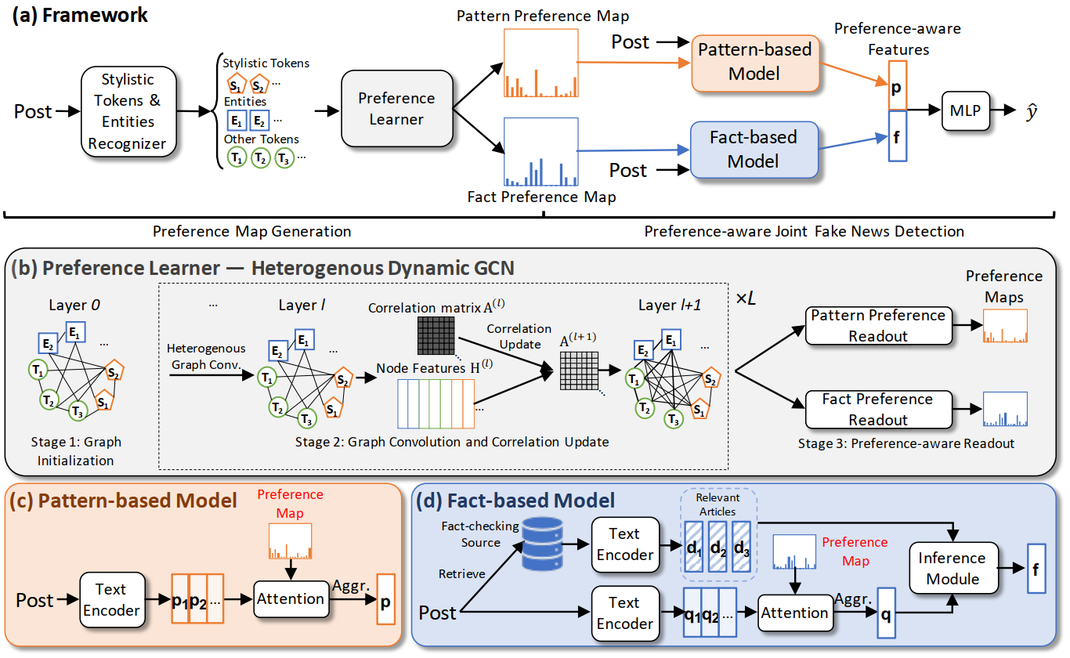

Slide 4
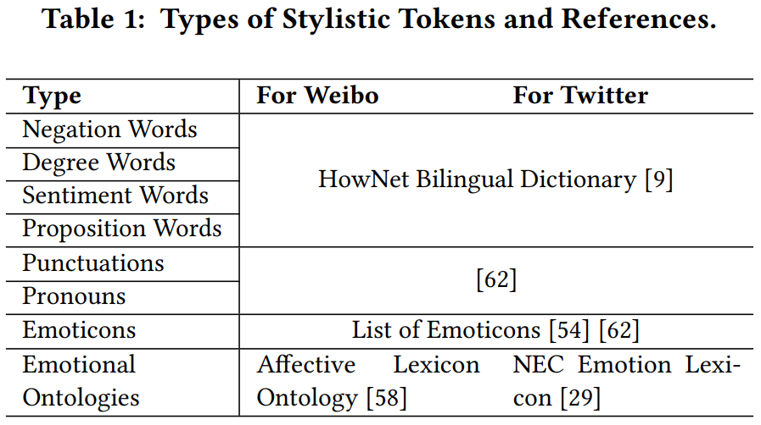
Generate Pattern Preference Map and Fact Preference Map：
Recognize tokens that are likely to represent writing styles or key objective elements：

Slide 5
Graph initialization:
The node representation is initialized with the pre-trained language model (BERT)：
The edge weights are initialized with calculating the cosine similarity of token pairs：

Slide 6
Graph Convolution & Correlation Update:
Preference-aware Readout:
is the submatrix of the correlation matrix of the 𝑙-th layer
rows contain all the nodes and columns record their correlation with nodes of the type

Slide 7
Preference-aware Joint Fake News Detection

Slide 8
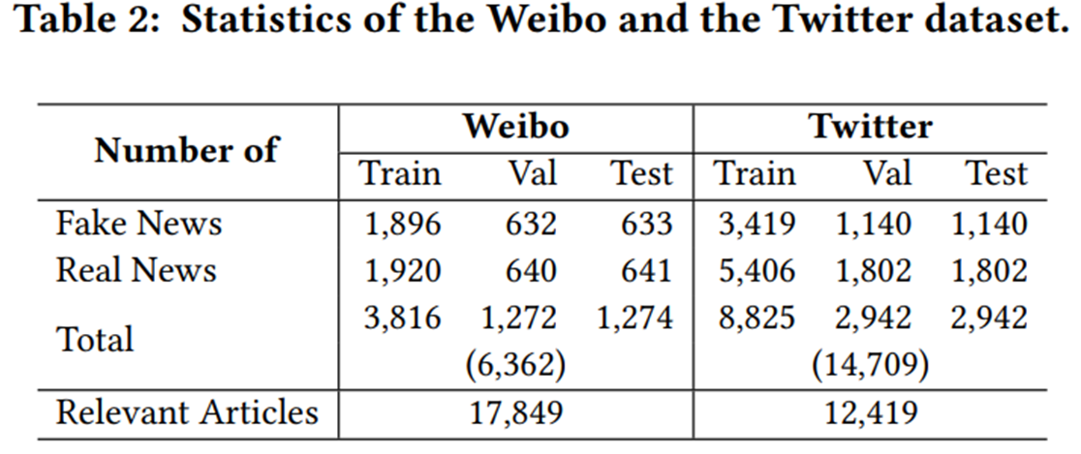
Experiments

Slide 9
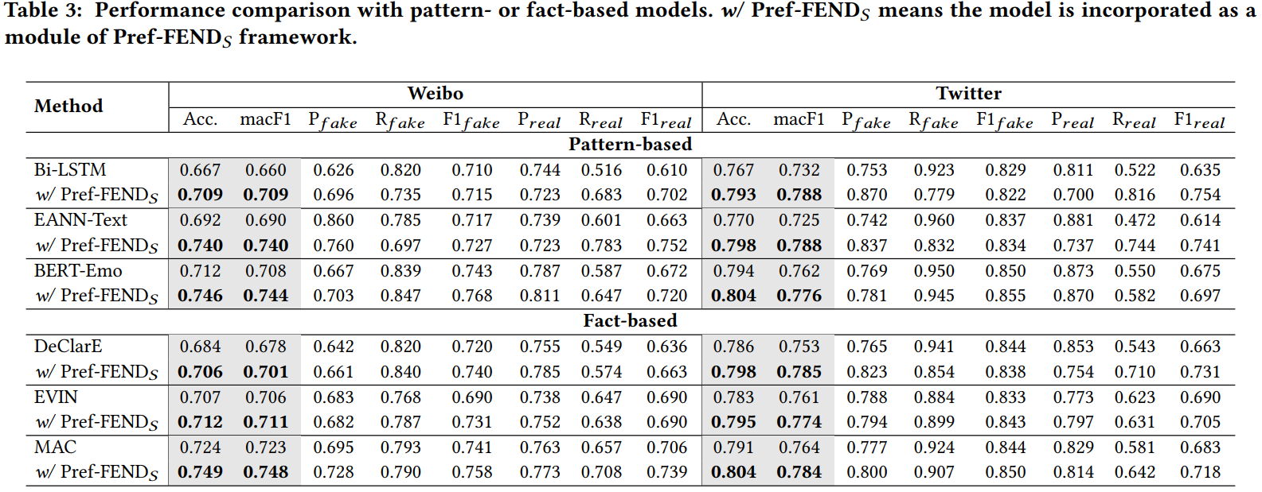

Slide 11
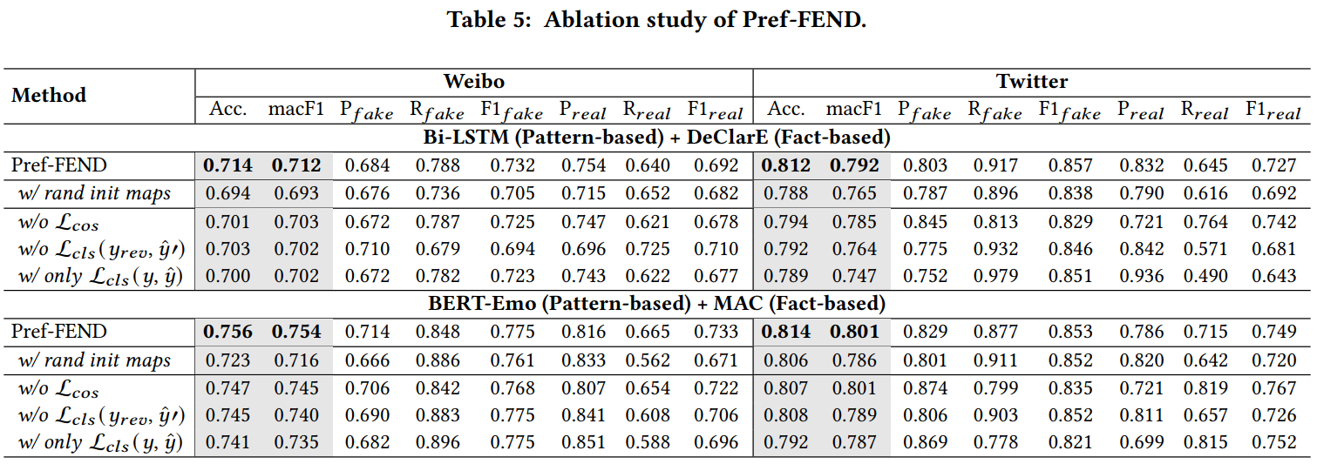

Slide 13
